Slide 1
Neeraj Sampath Venkata Mahalakshmi Naidu Karri
Final Project
3/21/2024 Annual Review

Slide 2
PROJECT TITLE
Keylogger and Security
3/21/2024 Annual Review

Slide 3


AGENDA
Introduction
Problem Statement
Project Overview
End Users
Solution and Value Proposition
Demonstrations
Results
3/21/2024 Annual Review

Slide 4

PROBLEM STATEMENT
“Keyloggers pose a significant threat to cybersecurity, leading to unauthorized access, identity theft, and financial fraud.”
3/21/2024 Annual Review

Slide 5

PROJECT OVERVIEW
Objective
Develop a comprehensive understanding of keyloggers, their types, and effective security measures to prevent attacks.
Scope
Analysis of hardware and software keyloggers, legal implications, and best practices.
3/21/2024 Annual Review

Slide 6

WHO ARE THE END USERS?
Individuals concerned about personal data security.
Businesses needing to protect corporate data.
Organizations requiring robust security measures.
Security professionals aiming to mitigate keylogging threats.
3/21/2024 Annual Review

Slide 7

YOUR SOLUTION AND ITS VALUE PROPOSITION
Solution
Implement a multi-layered security strategy including anti-keylogging software, system scans, and user education.
Value Proposition
Enhanced Security: Reduces data breaches and identity theft.
User Awareness: Educates about keylogging threats.
Compliance: Helps meet data protection regulations.
Innovative Approach: Combines technical measures with user education.
3/21/2024 Annual Review

Slide 8

THE WOW IN YOUR SOLUTION
Real-time demonstration of keylogger functionality.
Ethical emphasis on usage and security measures.
3/21/2024 Annual Review
8

Slide 9
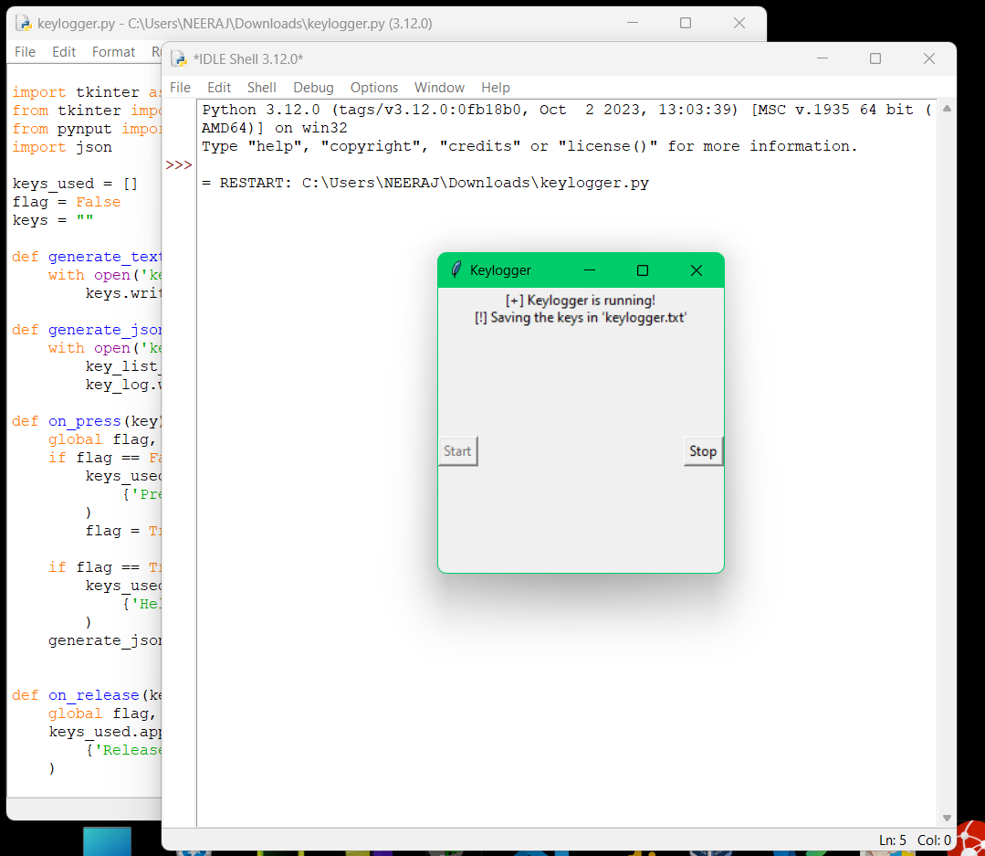
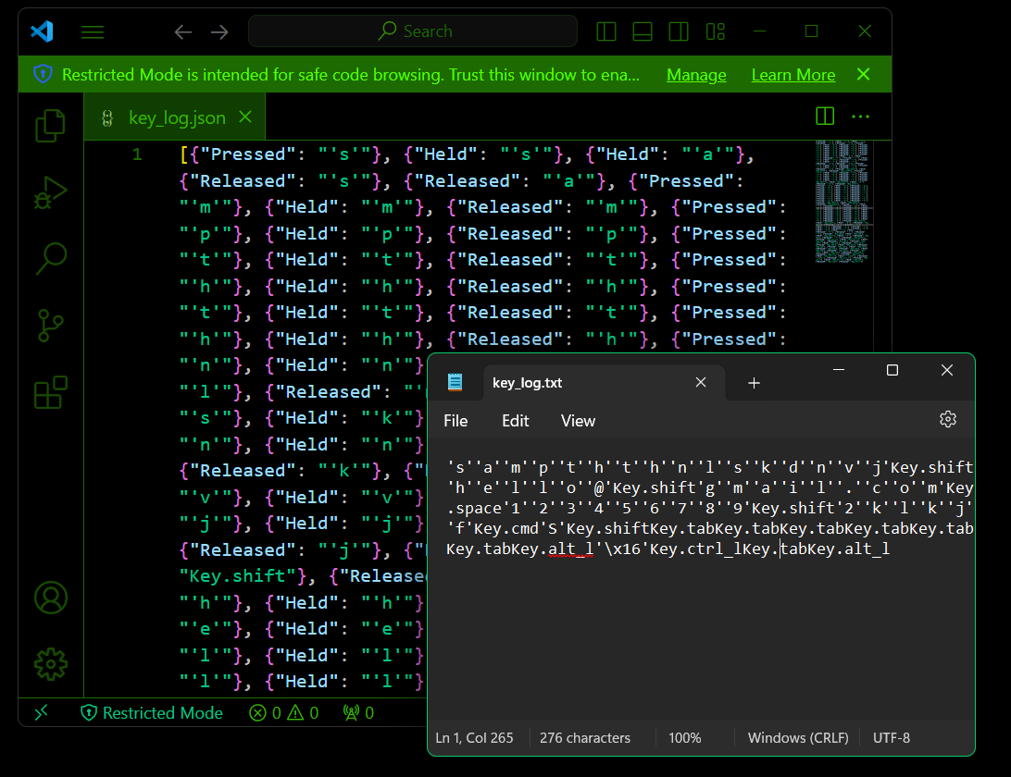
Demonstrations
Execution
Output
3/21/2024 Annual Review
9

Slide 10
RESULTS
Successfully implemented keylogger capturing keystrokes in real-time.
GUI integration for user-friendly control.
Ethical considerations and security measures highlighted.
3/21/2024 Annual Review
10

Slide 11
PROJECT LINK
GitHub Link: https://github.com/NeerajKarri96/KeyLogger.git

Slide 12
THANK YOU

